Slide 1
Cognition Mini Project – Chapter 8 AP Psychology
My College, My Future, My Dreams!
Lori Pham
Period 5
21 December 2012

Slide 2
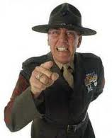
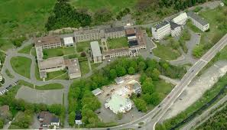
Concept/Prototype
When I think of college, my concept of it would be well-educated professors as well as challenging courses. These courses must provide a degree offering, or it would be pointless. A campus is also present for I image being able to get up every day to classes that are in a convent location. I prefer a small campus opposed from a large one because I want to be remembered and known by my professors throughout my years in college. If the student body is large, it will be hard for me and my professor to get to know each other. Sports teams are a must! Sports have been a part of me since I was very young, and I would like to carry along my interest.

Slide 3
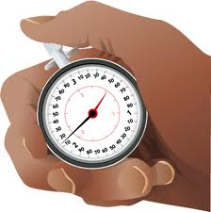
Reaction Time
Complexity: I am planning on getting a degree in Biology and eventually go on into the medical fielding possibly doing something with Biomedical engineering. Most medical degrees consists of a eight year education, which would be longer than a typical four year degree.
Expectancy: Based off of the AP courses I am taking in high school, I expect my college courses to be challenging. Therefore I am preparing myself mentally for the workload and intensity.
Stimulus-response compatibility: The campus of the college I will be attending has to be small and easy to navigate around. If I attend school at a big campus, I am sure to get lost a couple times and be late to some classes.
Speed-accuracy tradeoff: If a school I want to attend has a deadline coming up soon, I’ll have to rush to send in my transcripts, etc. so my decision will be made quickly opposed from taking time out to think further into it.

Slide 4
Schema
There are three types of schools I will avoid at all cost. One is being an all-girl’s school. Its been said that girls who attend an all-girl’s school will eventually catching feelings for females since they’re around them all the time. Second is being a community college. Its
been said that community colleges are for those who can’t
afford to go to a “real” college and those who aren’t smart enough to get accepted. Last but not least is taking online classes. Like a community college, its said that people who take online classes are ones who aren’t smart enough nor can afford a “real” college.
Scripts
The college I am planning on attending will have an eight year
plan. The reason why it must have an eight year plan is
because it is needed to be successful in the medical field.
I am aware that if I follow through with my plan, I will become
successful at all cost. After I get
my degree, I will be able to hold a good pay job so I can take care of my family.
Mental Models

Slide 5
Heuristics
Anchoring Heuristic: Top colleges such as Harvard and Yale will obviously be on my list to apply to, for I’m confident that I will get accepted, even though for most they would not dare to send their application. After I get my first rejection letter in the mail from Harvard, my confidence lowers and my estimate of getting accepted lowers as well. This leads to me eventually lowering my estimate in getting into Yale also.
Representative Heuristic: My image of a community college is for people who are not smart enough and cannot afford a “real” college. When in reality, those people are smart because they’re saving tons of money by doing so.
Availability Heuristic: The first time I got my rejection letter from a college I applied to for early decision, it was because of my SAT scores. This caused me to chose not to send in my SAT scores to the next college I decide to apply to for regular decision.

Slide 6
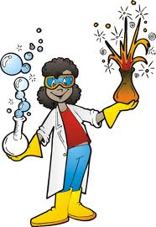
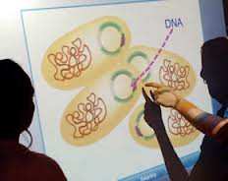
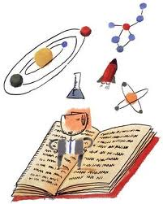
Means-End Analysis
Out of all the schools I am planning on applying to, I had to narrow it down to a few because of the amount I have to pay for the application fees. I decided to narrow it down to schools who have good Biology programs, since that is what I want to major in.

Slide 7
Obstacles to Problem Solving
Multiple hypothesis: As I am applying to colleges through the common application, I have to summit my personal statement and essay. I cannot seem to finish them however. The possible reasons could be due to my lack of sleep, being lazy or being too busy. So I decide to sleep more. However I am still lazy and too busy.
Mental set/functional fixedness: While I am completing my common application online, my laptop battery goes down to 5%. When this happens, my laptop automatically goes to sleep until a power source is added. I am not near an outlet therefore my laptop dies and I am not able to finish my application. I could have easily use my phone to finish it but I did not think of that at the time.
Ignoring negative evidence: After all the negative things I have heard about community colleges, I decided to visit and they have good programs.
Confirmation bias: With me not being able to complete my personal statement and essay for my common application, I blame it on my teachers for the workload I am given. I ignore how the work is getting me prepared for the AP exams I am going to take in a few months.

